Slide 1
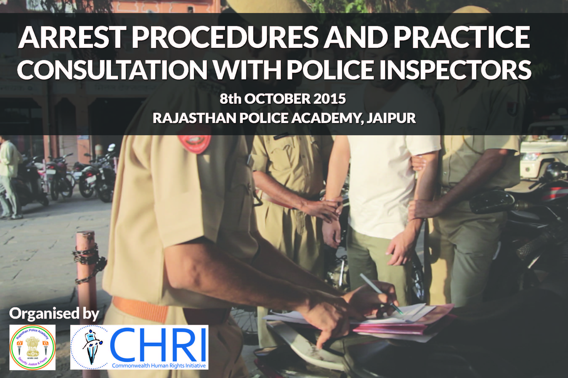

Slide 2
QUESTIONNAIRE BASICS
Number of Sections : 3
Number of questions asked : 47
Questions analysed: 47
Number of responses received: 239

Slide 3
SECTION A
BASIS FOR ARREST

Slide 4
1. Have you ever conducted an arrest?
Notes:
Q1

Slide 5
2. Does being named in an FIR make someone prima facie :

Slide 6
3. Police have the legal power to arrest. What is an illegal arrest?

Slide 7
4. When is an arrest not reasonable?

Slide 8
5. What is the difference between “arrest” and “detention”?

Slide 9
6. Do you forward the duly filled up arrest checklist to the magistrate?

Slide 10
7. Please mention whether you have issued a notice of appearance in cognizable cases where maximum punishment is less than 7 years?

Slide 11
8. What rationale guided you to issue notice of appearance instead of making an arrest?
Amendments to Section 41 CrPC (not arresting in cases of offence with less than 7 years of punishment) and Supreme Court judgment (Arnesh Kumar) – Maximum
41 (1) CrPC
41 (2) CrPC
Where suspect co-operates with investigation
To prevent an offence
Offence involves less than 7 years of punishment
Where there are no grounds for arrest
Where investigation does not require arrest
In the case of a woman suspect

Slide 12
9. What procedures do you follow while giving notice of appearance?
Serving notice to concerned accused under section 41 CrPC – if the person appears then there is interrogation – 1
When you are not convinced enough of the need for arrest you give the person notice to appear within 15 days time - 4
Giving fixed date and time for appearance of the person to be interrogated - 1
As per CrPC – 1
Notice is not served to persons below the age of 15 and above 65, nor to women - 1
Notice is served to concerned person within 15 days from the date of institution of the case – 1
Using checklist as per procedure – 2
Implementation of 41 A – 1
After serving notice, investigation is conducted and depending on results the person is produced in court – 1
Reasons for serving notice are provided in writing and then the notice is served; procedures are detailed and offences mentioned in the notice – 2

Slide 13
10. Can a notice of appearance be issued any time after the FIR is filed?

Slide 14
10d. Specific Reasons for the answer

Slide 15
11. When you issue a notice of appearance to a person how do you ensure that he will not tamper with the evidence or intimidate the witness?

Slide 16
12. How long can you detain a person who has appeared before you under notice?

Slide 17
13. Do you inform the court in case a notice of appearance has been issued to a person? If yes, when?

Slide 18
14. How often do you record reasons for arresting/ not-arresting a person?

Slide 19
15. How often do you come across cases where people do not comply with the terms of the notice?

Slide 20
16. What action do you take when people do not comply with the terms of the notice?

Slide 21
Are lawyers usually present during detention of a suspect when called through a notice of appearance issued by the police?

Slide 22
SECTION B
ARREST MEMO

Slide 23
1. In your police station, is an arrest memo filed for every arrest made?
Notes:
Q1

Slide 24
2. Do you prepare an arrest memo in cases of bail-able offences?
Notes:
Q2

Slide 25
3. Which of the following are commonly included in an arrest memo:
1. Signature of the accused, 2. Signature of Witness,
3. Time, place and date of arrest, 4. Signature of arresting officer

Slide 26
4. In your view, what is the purpose of an arrest memo?

Slide 27
5. Does it help the police in their work to have arrest memos? How?
Helps in complying with legal provisions – 3
Useful in recording injuries and ensuring medical examination that will help to protect against allegations- 2
It’s a record with the police(eg., records the time and place of arrest) and helps in procedural compliance-5
It helps the investigation – 3 (eg., it gives time for investigation; helps in collecting evidence -Saboot ekatrit karne mein)
Provides full description of the accused (biodata of accused and photo) – 2
Helps the court - 1
Gives the date and time of presentation in court - 1
60 and 90 days mein chargesheet dene mein madad milti hai - 1
Establishes the identity of the accused – 2
Prevents further Judicial Problems-1
Prevents illegal custody-1
Helps in remand-1
Compliance with human rights-1
Helps the accused during trial - 1
Brings transparency to police work – 1
Recovery made through the statements made by the accused under Section 27 of the Evidence Act helps in convicting the accused - 1
Notes:
Q5

Slide 28
6. If you have been an SHO, did you check the arrest memo whenever a suspect was brought to the Police Station immediately after arrest?

Slide 29
8. If you find an arrest memo has not been prepared, what action do you take?

Slide 30
10. If an arrest has to be made at the scene of the offence, is the arrest memo filled in at the scene?

Slide 31
11. If your response to question 10 was rarely or never, then in such cases, are arrest memos drafted once the accused is brought back to the police station?

Slide 32
12. In the situations mentioned in question 11, how long does it usually take to draft the arrest memo after arrest?

Slide 33
Which of the following are commonly included in an arrest memo:
1. Signature of the accused, 2. Signature of Witness,
3. Time, place and date of arrest, 4. Signature of arresting officer
Notes:
Q3

Slide 34
Who can sign the arrest memo as a witness:
1) Family member of suspect, 2) Friend of suspect, 3) Person from locality where arrest is made, 4) Police Officer, 5) Lawyer
Notes:
Q14

Slide 35
What do you do when you don’t find independent witnesses?
We make police personnel like guards or other staff the witnesses in such cases
We take the help of people who help the police
We try to have at least one independent witness
We make a note in the diary and we ask the police personnel accompanying us to become the witness
Notes:
Q17

Slide 36
When is the arrest memo prepared?
Notes:
Q7

Slide 37
15. Does the arresting officer usually find the independent witness?

Slide 38
If you find an arrest memo has not been prepared, what action do you take?
Will clarify the reasons why arrest memo could not be prepared and then prepare the memo – 2
We prepare the arrest memo – 9
We find out reasons why arrest memo was not made – 1
Inquire as per procedure – 1
We advise the IO to prepare it immediately after – 1
Arrest memo will be prepared later if there is evidence against the person otherwise he will be released after interrogation – 1
This has never happened – 1
If an offence is made out then arrest will be done otherwise case will be dropped – 1
Notes:
Q8

Slide 39
Where is the arrest memo prepared?
Notes:
Q9

Slide 40
Please list the practical difficulties faced by the arresting officer in the drafting of the arrest memo at the scene of the offence.
Law and order situation – 6
Shortage of guards- 1
Crowd management - 1
Obstructions from relatives of the accused – 3
Friends of the accused may attack to prevent the arrest or help the accused to escape – 2
Difficulty in finding independent witness – 10 (eg. Common man hesitates to become a witness)
Witnesses refuse to sign – 1
Difficulty in informing the relatives of the arrested person – 1
Difficulty in informing about the arrest from the place of offence - 2
Problem in examining the medical condition of the person being arrested – 2
Risk of harm to the accused in the place of offence – 1
No time for investigation- 1
Risk of arresting wrong person as the witnesses could not be examined at the place of incident-1
There are a lot of investigative work to be done at the place of incident that is why suspect is only detained and not arrested- 1
Lack of sitting arrangement at the place of incident-1
Lack of lighting arrangement in villages-1
Paper work is problematic on the spot-1
Takes a lot of time to establish the correct facts-1
Difficult to do justice to the wanted person – 1
Notes:
Q13

Slide 41
19. Has the Rajasthan Police devised a standard format for arrest memo?

Slide 42
Does the Investigating Officer (IO) keep a copy of the arrest memo in the case diary of every case?
Notes:
Q18

Slide 43
Does the magistrate check the Arrest Memo at first production?
Notes:
Q20

Slide 44
What are the usual queries raised by magistrates on the review of the arrest memo?
When did you arrest – 5
Did you report the arrest – who to - 3
Did you inform the arrest to relatives of the arrested person-4
Whether the signatures of the accused and witness are present - 1
Whether the person produced is the same as the person who was arrested – 1
What offence was committed – 3
Name, address, age, medical examination of the suspect, injuries - 6
Where did you arrest-6
Why did you arrest (reasons)-2
Why do you need remand – 1
Magistrate asks for checklist-1
Notes:
Q21

Slide 45
Are police station staff given any training or information about memos of arrest?
Notes:
Q22

Slide 46
Do you have any suggestions that will make it easier for Investigating Officers to use the arrest memo properly and which will help the magistrate and the accused?
The form can be simplified – 1
Copy of arrest memo to be provided to family member - 1
Photograph of arrested person to be made mandatory on the arrest memo – 1+1+1
Mobile number of arrested person to be made mandatory mention on the arrest memo – 1+1
Injuries should be clearly described – 1+
Medical condition of the arrested person should be noted in the arrest memo-1+1
Details of the person informed about the arrest should be noted down mandatorily- 1+
The requirement of independent witness is unnecessary as independent witnesses only look to their own interests and there is nothing to be gained in particular by them - 1
Clear description of the appearance of the accused-1+
Signature of the arrested person to be mandatorily taken-1
Signature of the relative or witness to be taken – 1+
Mobile number of person informed of the arrest- 1+
Should be filled up properly-1+
Should be filled up immediately after arrest-1
Relatives of the arrested person should be informed-1+1
Complying with provisions of Section 41 CrpC, D.k. Basu and and Arnesh Kumar Judgment-1+1
Notes:
Q23

Slide 47
SECTION C
PRESENCE OF LAWYER DURING CUSTODY

Slide 48
1. Are lawyers usually present during interrogation?

Slide 49
2. Should lawyers be present during the period of interrogation?

Slide 50
2d. Please specify reasons for your answer:

Slide 51
3. How does lawyer’s presence interfere with the interrogation?

Slide 52
4. Is legal aid a fundamental right?

Slide 53
5. Are police stations regularly in touch with the District Legal Services Authority?

Slide 54
6. Is there a register maintained to record the visits by lawyers at the police station?

Slide 55
7. How do you ensure that the arrested person is represented by a lawyer at the time of interrogation?

Slide 56
8. Are lawyers usually present during detention of a suspect when called through a notice of appearance issued by the police?

Slide 57
THANK YOU!

