Slide 1
Opening up Prisons
Status of Proactive Disclosure of Prison Department in Rajasthan & West Bengal
Raja Bagga
Mrinal Sharma

Slide 2
Sources of Information
The Prison Website
The Citizen Charter
The Prison Notice Board
Other Sources of Dissemination
The RTI Disclosure Manual

Slide 3
The Degree of Disclosure
Completeness of the Data
Specificity of the Data
Frequency of Updation
Visibility of the Data
Language

Slide 4
The Rajasthan Experience

Slide 5
Disclosures made
Statutory Requirement | Response
The rules, regulations, instructions, manuals and records, held by it or under its control or used by its employees for discharging its functions | List of Acts & Rules ( Uploaded) Government Orders & Tenders Prisoners Profile Mulaqat Process, List of vacancies
Directory of its employees and officers | Detailed Information Multiplicity of Records
Facilities Available to Public to obtain Information | RTI Act Details & Website
Disclosures Avoided
Statutory Requirement | Response
Power & Duties of its Officers & Employees | As per Jail Manual 1951
Norms set by it for the discharge of its function | Governed by the Rajasthan Government Office Manual & Rajasthan Prison Rules, 1951.
Statements of the categories of documents held by them | As per Rajasthan Jail Manual 1951
Procedure followed in decision making | Summary Disclosure

Slide 6
Neither here nor there
Statutory Requirement | Response
Remuneration to Employees | Manual- Allowance, Website- Not Updated Visibility
Budget Allocation | Manual- Incomplete Administrative Report- Not Detailed
Information Available in Electronic Form | Broad Nine Heads
Actions thwarted
Statutory Requirement | Responses
Statements of the categories of documents held by them | As per the Rajasthan Jail Manual 1951
Statements of Boards, Councils, Committees | Incomplete List, Minutes only of the Open Jail meetings & Parole Meetings, PRC, BOV, Shortening- Only reference
Name, Designation & particulars of PIO | Only the designated & Appellate Authority, No phone numbers & Addresses

Slide 7
The West Bengal Experience

Slide 8
Disclosures not made
Disclosures Made
Statutory Requirement | Response
Particulars of its organisation, functions and duties | Details on the Charter & Website
Directory of its officers and employees | Updated List with all details
Powers and duties of its officers and employees | Details of powers & duties of the officers
Norms set by it for the discharge of its functions | The West Bengal Correctional Services Act 1992 Uploaded
Procedure for Decision making process | The Correctional Act
Statutory Requirement
Statement of the categories of documents held by it or under its control
Budgets allocated to each of its agency
Information Available in Electronic Form

Slide 9
Incomplete Disclosure
Statutory Requirement | Responses
The rules, regulations, instructions, manuals and records, held by it or under its control or used by its employees for discharging its functions | List of all the Acts, Rules ( Specific- Mulaqat Process), Diets, Government Orders, Notifications, Prisoners Profile
Remuneration of officers & employees | Only Grade A Employees
Action Thwarted
Statutory Requirement | Responses
Statements of the categories of documents held by them | No Response
Statements of Boards, Councils, Committees | Only List, Minutes not available for any board
Name, Designation & particulars of PIO | Only the designated Authority. No phone numbers & Addresses

Slide 10
NEED AREAS

Slide 11
People who ‘need’ Disclosure
Prisoner
Prisoner’s Family
Anyone working on the rights of prisoners

Slide 12
“Minimum Resort”
Easily Accessible
Cost effective
Reduce burden on Administration
Shift the focus from Section 6 to Section 4
Factors: Formulating the need areas

Slide 13
THE AREAS
BROAD STATUTORY NEEDS
Minutes of Meeting
4(1)(b)(viii)
JAIL MANUALS
4 (1)(b)(III) & (V)
Schemes & Subsidy Programmes
4(1)(b)(xii)
FORMS
4(1)(b)(iv) & (v)
PRISON OVERSIGHT MECHANISMS
4 (1)(b)(VII) & (VIII)
Legal Aid Facilities
4(1)(b)(xiii)
Detailed Information of Personnel
4(1)(b)(ii) & (ix)
Medical Officers
Probation Officers
1. Prison Oversight Mechanisms
- Prison Visiting System
- Board of Visitors
- Non Official Visitors
- Ex-Officio Visitors
2. Periodic Review Committees
3. Jail Adalats

Slide 14
SPECIFIC STATUTORY NEEDS
Deaths in Judicial Custody
Landmark Judgments and compliance
RD Upadhyaya vs. State of AP
Sunil Batra vs. Delhi Administration
Bhim Singh vs. Union of India
NCRB DATA
Useful links
Jail specific
Natural Deaths
Unnatural Deaths
Suicides
Death due to Firing
Death due to assault
Murder by inmates
Execution
List of Legal Aid Lawyers and their timings
List of RTI applications filed
Inmate: Staff Ratio
List of Vacancies
Details of NGOs functioning inside the prison
Releases
S. 436A
S. 167
Completion of Sentence
Premature Releases
Prison Training Institutes and the Courses

Slide 15
CHALLENGES

Slide 16
The Challenges
Section 8 of the RTI Act
Attitude of not ceding information & Intrinsic Opaqueness
Regular Updation & Strength
Incompleteness ,Visibility & Language

Slide 17
Special Disclosures

Slide 18
GOOD PRACTICES

Slide 19
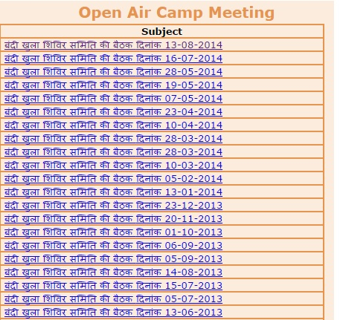
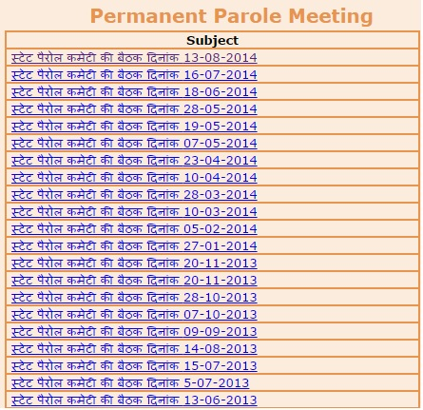
RAJASTHAN
NATIONAL

Slide 20
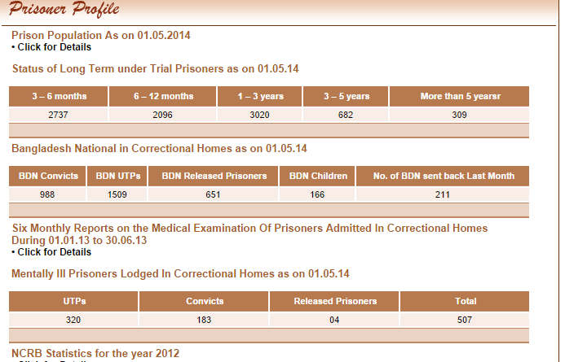
WEST BENGAL

Slide 21
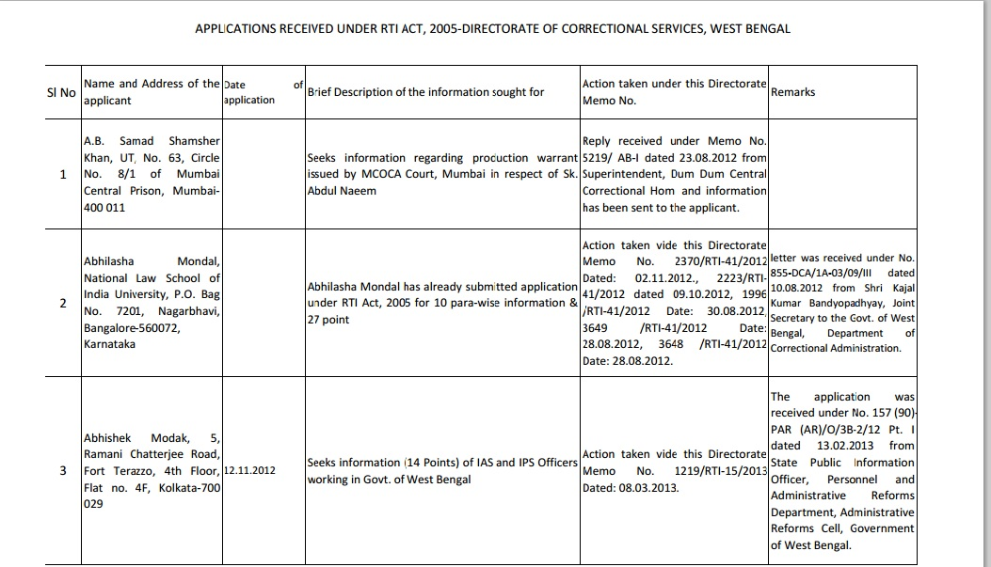

Slide 22
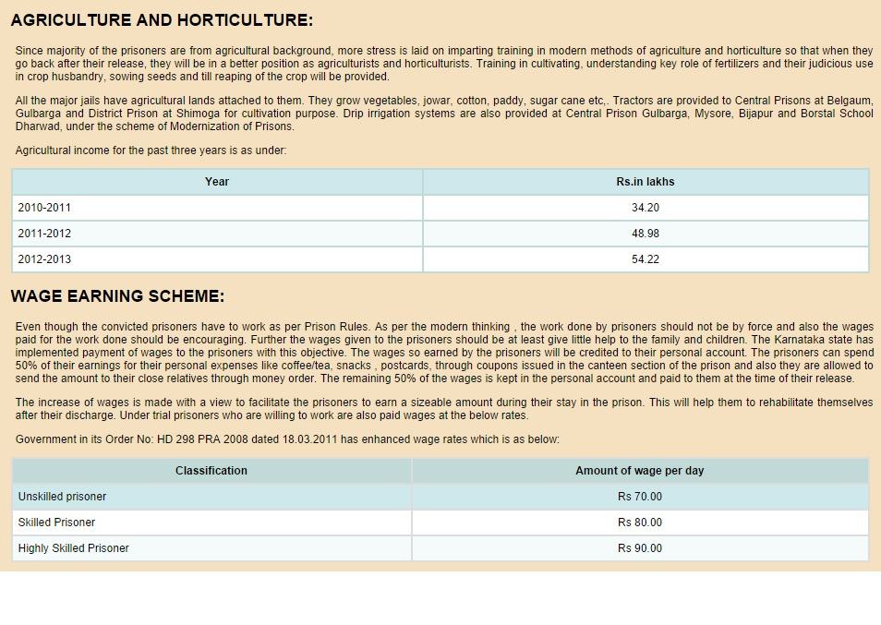
KARNATAKA

Slide 23
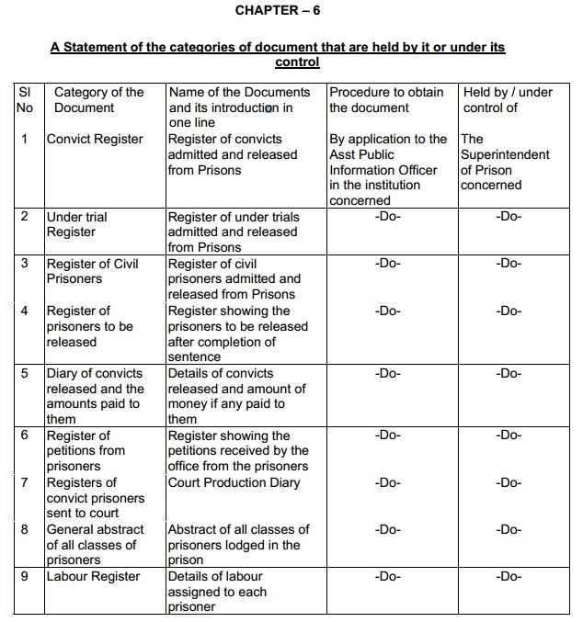
TAMIL NADU

Slide 24
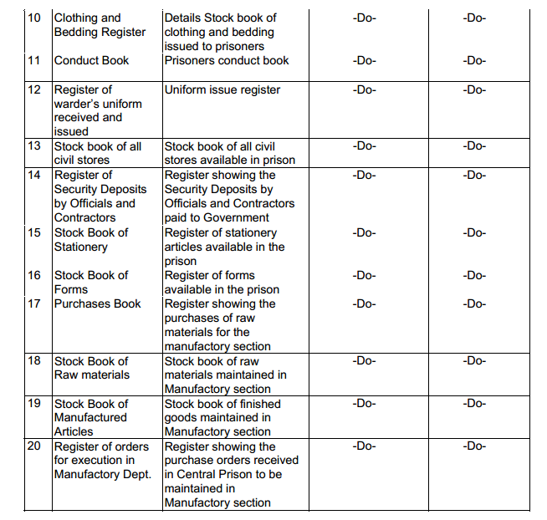

Slide 25
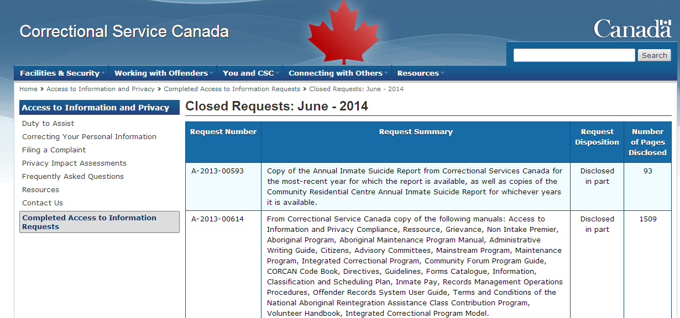
INTERNATIONAL

Slide 26
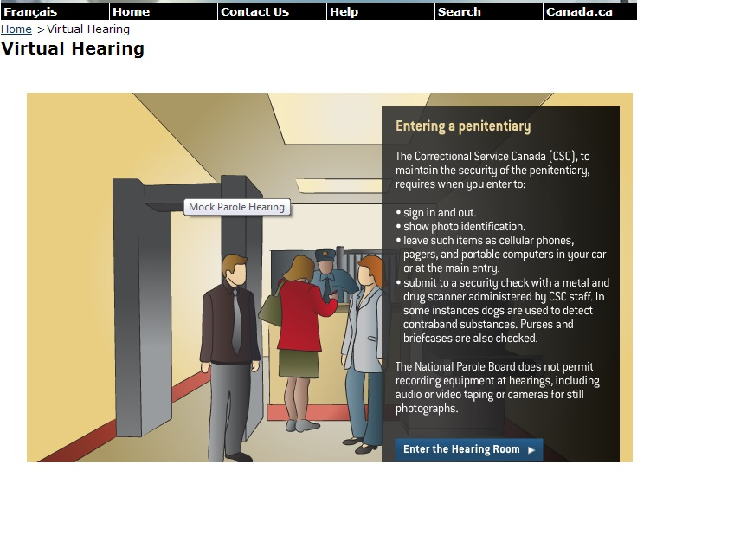

Slide 27
United States of America

Slide 28
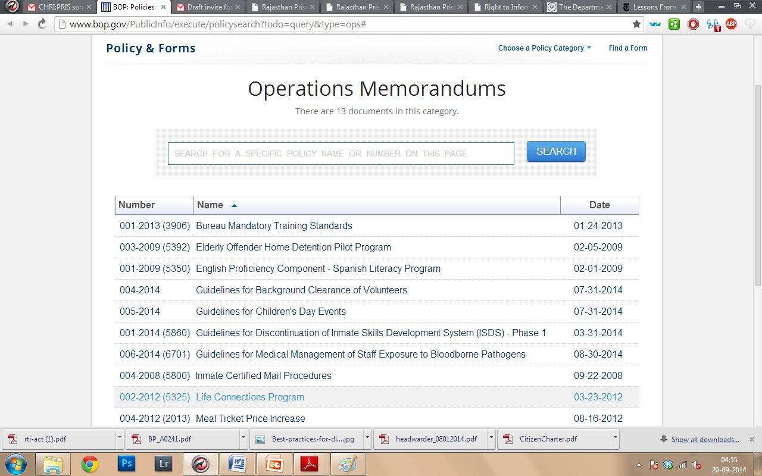

Slide 29
Thank You

